Slide 1
Web Design 101
Design is not just what it looks like and feels like. Design is how it works.

Slide 2

Before we begin
I have taken the time to highlight certain slides using . These slides are the most important to learn.
I don’t expect you to learn off any definitions, dates or names. I do expect you to have your own understanding of these lectures. Giving my notes back word for word in an exam will only net you so many marks

Slide 3
Web Design
Web design consists of three core elements
Design
Development
Deployment
The design phase should be the most rigorous phase. 2x effort here saves 4x effort in the long run

Slide 4
Design
The design phase consists of three main activities. Requirements gathering, wireframing and prototyping.
Requirements gathering is the most important part of the design process
This is true of all computing projects; not just Web Design
Requirement specification means communication with clients

Slide 5
Clients
All sites/apps have end users. Your clients may be these end users, or they may be an organisation targeting these end users. As a developer you must understand the needs of clients and end users.
That being said...

Slide 6



Clients from hell

Slide 7
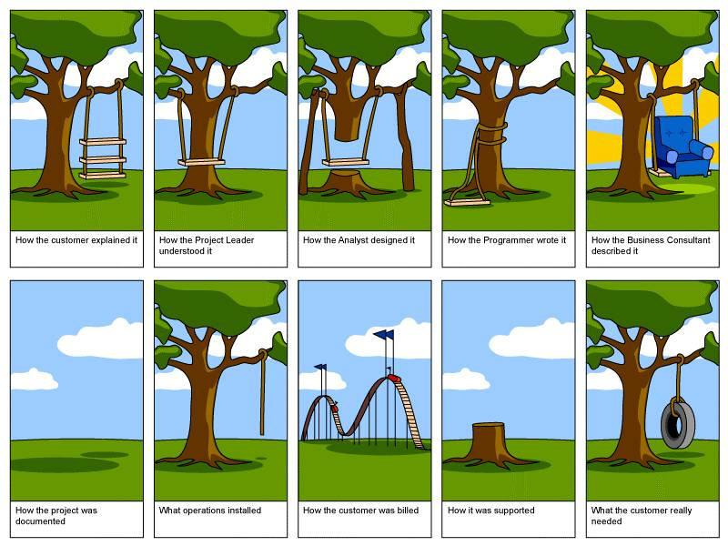

Slide 8
Exercise
Split into teams of 2-3
5 minutes
Come up with 5 good questions to ask a client when beginning the design process
Remember! A good requirements specification will save you time and ultimately money by avoiding scope creep

Slide 9
Development
This is the actual build process. A build process with a good req spec might take a week, one without may take months.
By the time a developer gets to code, they should know exactly what functionality is needed
Basic websites are built using client-side languages such as HTML, CSS and JavaScript

Slide 10
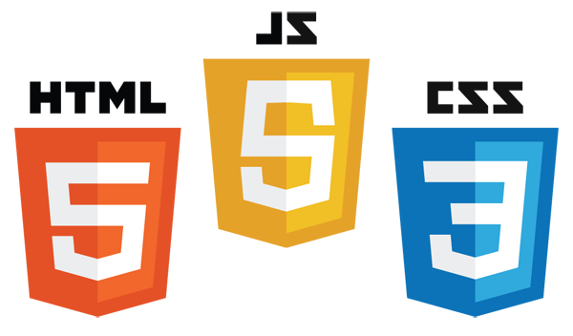

Slide 11
Web Development Languages
HTML stands for Hyper Text Markup Language
HTML is used to add content such as images, text, audio and video.
CSS stands for Cascade Style Sheets.
CSS is only concerned with style. This means how a page looks eg text color, font size, image rotation
JavaScript is concerned with behaviour. Based on a user’s interactions with a site it will allow the site to react dynamically.

Slide 12

Behaviour examples
Go to http://konamicodesites.com/ and perform the Konami Code
( ↑ ↑ ↓ ↓ ← → ← → B A Return)
Remember, Java and JavaScript have nothing to do with eachother.

Slide 13
Deployment
Deployment is the act of putting a site live. This may be on the internet, or in an organisation’s Intranet.
Websites are hosted on servers, and require 2 elements; Domain names and Hosting

Slide 14

Domain names
Domain names are the names of sites.
Eg www.samcogan.me
Domain extensions are the bits at the end of a web address
Eg www.samcogan.me

Slide 15
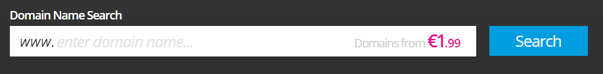
Exercise
Choose a domain name for a business you might like to set up. Go to http://register365.com and see what’s available.
Make sure to check the different domain extensions available and their prices

Slide 16
.ie or .com?
Choosing from one of the many domain extensions can be difficult.
.ie domains cost slightly more than .com, but have better SEO (Search Engine Optimisation) in Ireland.
To own a .ie you must be an Irish citizen, be trading within Ireland or be giving some information relevant to Ireland. This is managed by the IEDR

Slide 17
Avoid bad domain names..
http://www.popsugar.com/love/Top-10-Unintentionally-Bad-Website-Addresses-71649
http://www.boredpanda.com/worst-domain-names/

Slide 18
Any questions?

